Slide 1
DHCP Overview

Slide 2
Agenda
Overview
Initial Message Flow
PDU Format
Relay Agents

Slide 3
Motivation for DHCP
Configuration parameters for network hosts
  IP address
  Router
  Subnet Mask
  Many more…
Before DHCP
  Manual assignment
  RARP
  BOOTP

Slide 4
BOOTP
BOOTP: BOOTstrap Protocol
  From 1985
  Host can configure its IP parameters at boot time.
  3 services:
    IP address assignment.
    Detection of the IP address for a serving machine.
    The name of a file to be loaded and executed by the client machine (boot file name)
Not only assign IP address, but also default router, network mask, etc.
Sent as UDP messages (UDP Port 67 (server) and 68 (host))
Use limited broadcast address (255.255.255.255):
  These addresses are never forwarded

Slide 5
DHCP Overview
DHCP: Dynamic Host Configuration Protocol
  From 1993
  An extension of BOOTP, very similar to DHCP
  Same port numbers as BOOTP
Extensions:
  Supports temporary allocation (“leases”) of IP addresses
  DHCP client can acquire all IP configuration parameters needed to operate
DHCP is the preferred mechanism for dynamic assignment of IP addresses
DHCP can interoperate with BOOTP clients.

Slide 6
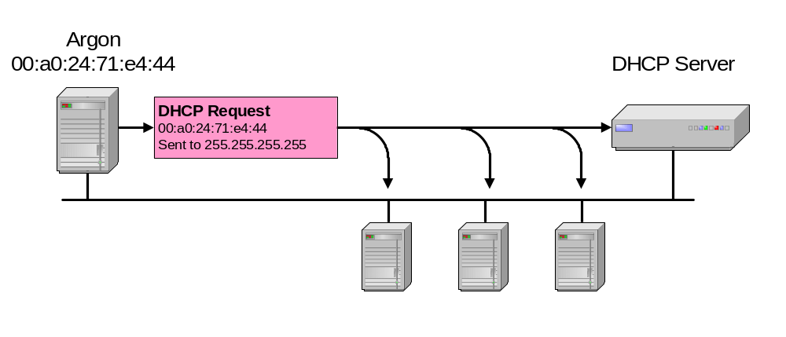
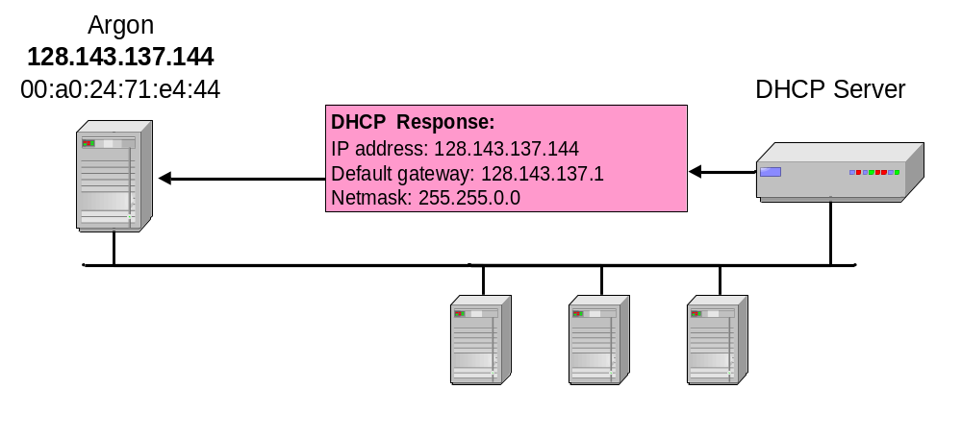
DHCP Interaction (simplified)

Slide 7
Initial Message Flow
Server A
Client
Server B
Client attempts to discover available DHCP servers
DHCPDISCOVER
DHCPDISCOVER
Servers reply with offers
DHCPOFFER
DHCPOFFER
Client collects offers and decides which offer to accept
Client broadcasts request for one of the received offers
DHCPREQUEST
DHCPREQUEST
Server acknowledges client’s use of IP address
Configuration complete
DHCPACK
Graceful shutdown
Client explicitly releases use of IP address
DHCPRELEASE

Slide 8
DHCP Message Types
DHCP Message | Use
DHCPDISCOVER | Client broadcast to locate available servers
DHCPOFFER | Server to client response offering configuration parameters
DHCPREQUEST | Client broadcast requesting offered parameters
DHCPDECLINE | Client to server notification that IP address is in use
DHCPACK | Server to client response confirming a request
DHCPNAK | Server to client response denying a request
DHCPRELEASE | Client to server request to relinquish IP address
DHCPINFORM | Client to server request for configuration parameters

Slide 9
DHCP PDU Format
32 Bits
Operation Code | Hardware Type | Hardware Length |  | Hop Count
Transaction ID
Seconds Elapsed |  | B | Must Be Zero (MBZ)
Client IP address
Your IP address
Server IP address
Relay agent IP address
Client hardware address (16 bytes)
Server host name (64 bytes)
Boot file name (128 bytes)
Options (up to 312 bytes)
Magic Cookie

Slide 10
Message Fields
code: Indicates a request or a reply
  1 Request
  2 Reply
HWtype: The type of hardware, for example:
  1 Ethernet
  6 IEEE 802 networks
length: Hardware address length in bytes. E.g., Ethernet and token-ring both use 6 bytes.
hops: The client sets this to 0. It is incremented by a router that relays the request to another server and is used to identify loops. RFC 951 suggests that a value of 3 indicates a loop.

Slide 11
Message Fields (Cont.1)
Transaction ID: A random number used to match this boot request with the response it generates.
Seconds: Set by the client. It is the elapsed time in seconds since the client started its boot process.
Flags field: The most significant bit of the flags field is used as a broadcast flag. All other bits must be set to zero, and are reserved for future use. Normally, DHCP servers attempt to deliver DHCP messages directly to a client using unicast delivery. The destination address in the IP header is set to the DHCP your IP address and the MAC address is set to the DHCP client hardware address. If a host is unable to receive a unicast IP datagram until it knows its IP address, then this broadcast bit must be set (=1) to indicate to the server that the DHCP reply must be sent as an IP and MAC broadcast. Otherwise this bit must be set to zero.

Slide 12
Message Fields (Cont.2)
Client IP address: Set by the client. Either its known IP address, or 0.0.0.0.
Your IP address: Set by the server if the client IP address field was0.0.0.0.
Server IP address: Set by the server.
Router IP address: This is the address of a BOOTP relay agent, not a general IP router to be used by the client. It is set by the forwarding agent when BOOTP forwarding is being used
Client hardware address: Set by the client. DHCP defines a client identifier option that is used for client identification. If this option is not used the client is identified by its MAC address.

Slide 13
Message Fields (Cont.3)
Server host name: Optional server host name terminated by X'00'.
Boot file name: The client either leaves this null or specifies a generic name, such as router, indicating the type of boot file to be used. In a DHCPDISCOVER request this is set to null. The server returns a fully qualified directory path name in a DHCPOFFER request. The value is terminated by X'00'.
Options: Subnet Mask, Name Server, Hostname, Domain Name, Forward On/Off, Default IP TTL, Broadcast Address, Static Route, Ethernet Encapsulation, X Window Manager, X Window Font, DHCP Msg Type, DHCP Renewal Time, DHCP Rebinding, Time SMTP-Server, SMTP-Server, Client FQDN, Printer Name, …

Slide 14
DHCP Options
Magic Cookie:
99 | 130 | 83 | 99
4 bytes
Option format:
Code | Length | Data
1 byte
1 byte
Length bytes
Subnet Mask:
1 | 4 | 255 | 255 | 255 | 0
One-byte options:
0
Padding
255
End of options

Slide 15
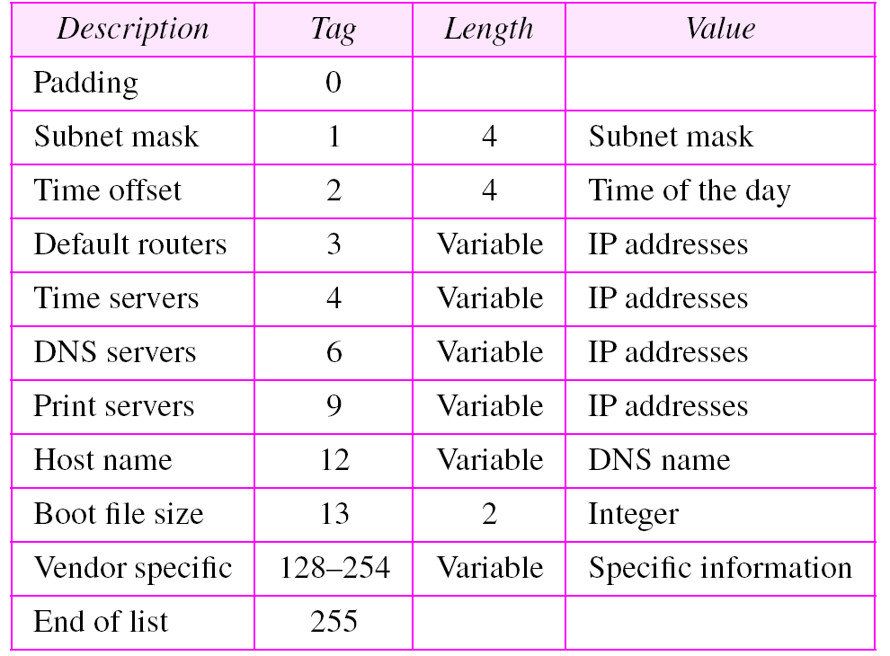
DHCP Option Examples

Slide 16




Another Sample Network
DHCP Clients
Relay Agent within
Router
Internet
DHCP Server

Slide 17
DHCP Relay Agents
Remove restriction of having DHCP server on every network
Listen for DHCP messages and transmit them to appropriate machine
Client to server relay
  Broadcast from client → Unicast to server(s)
Server to client relay
  Broadcast from server → Broadcast to client
  Unicast from server → Unicast to client

Slide 18
Option 60
Briefly speaking, this feature allow switch to watch option 60 and 61 content of DHCP client packet to decide to relay the packet to which DHCP server or simply drop it
Vendor Class Identifier (Option 60) can be used by DHCP clients to identify the vendor and functionality of a DHCP client. The information is a variable length string of characters or octets which has a meaning specified by the vendor of the DHCP client.

Slide 19
Network Diagram
D-Link Set-Top Box DHCP Server with VCI to “dlink”
192.168.0.2/24
10.90.90.91/8
192.168.0.1/24
Internet DHCP Server (default Server)
192.168.0.3/24
DGS-3612
DES-3526 (10.90.90.90)
Need assign IP by the Set-Top Box DHCP Server
D-Link Set-Top Box Client With Option 60 specified string “dlink”
Internet Clients
Need assign IP by the Internet DHCP Server
Notes:
For example,
1. You might have an environment in which some DHCP clients require only Internet access, while other clients require IPTV service.
2. The clients that need Internet access get their addresses assigned by the DHCP local server on the E-series router (in equal-access mode).
3. Clients requiring IPTV must be relayed to a specific DHCP server that provides the service. To support both types of clients, you configure two option 60 strings on the DHCP relay. 4. Now, when any DHCP client packets are received with option 60 strings configured, the strings are matched against all strings configured on the DHCP relay.
5. If the client string matches the first string you configured, that client is directed to the DHCP local server and gains Internet access.
6. Client traffic with an option 60 string that matches your second string is relayed to the DHCP server that provides the IPTV service.
7. In addition, you can configure a default action, which DHCP relay performs when a client option 60 string does not match any strings you have configured—for example, you might specify that all clients with non-matching strings be dropped.

Slide 20
Option 61
This option is used by DHCP clients to specify their unique identifier. DHCP servers use this value to index their database of address bindings
With option 61 all DHCP clients send a client identifier (DHCP option 61) in the DHCP packet
Example: Switch will add the client’s MAC address to option 61 field in the DHCP request packet
The DHCP Sever will check the client identifier information (for example MAC address) to assign a corresponded IP address to the Client base on it’s address Binding table

Slide 21
Option 82
To put it simply, DHCP Option 82 is the “DHCP Relay Agent Information Option”
Option 82 was designed to allow a DHCP Relay Agent to insert circuit specific information into a request that is being forwarded to a DHCP server. Specifically the option works by setting two sub-options:
  Circuit ID. Ex: a port on a switch,..
  Remote ID. Ex: MAC address of the relay agent, a unique identifier of the wireless access point,..

Slide 22
DHCP Pros and Cons
Pros
- Simplifies the task of assigning IP numbers to each machine in the network
- Makes easy to add, remove or move a host
- Can assign defaults: default gateway, domain name, DNS server, WINS server (if any) .
- Ability to have fewer IP# than hosts
Cons
  - If DHCP server is down, all hosts are down
  - Hard to keep information on free and used IP #

Slide 23
Q&A

